Slide 1
Coding seminar
12/07/2023
Lesson 1: Get ready to code: prepare your environment
Ikue Hirata, PhD
ikue.hirata@iit.it

Slide 2


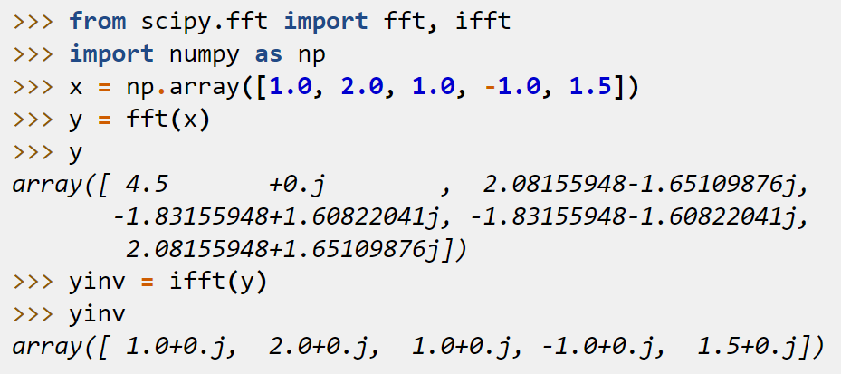

Aim of this course 1/2
“Fourier transform Python”
I need to Fourier transform multiple .csv files…
Where to type these?
What is >>>?
Where are inputs?
How to save results?

Slide 3
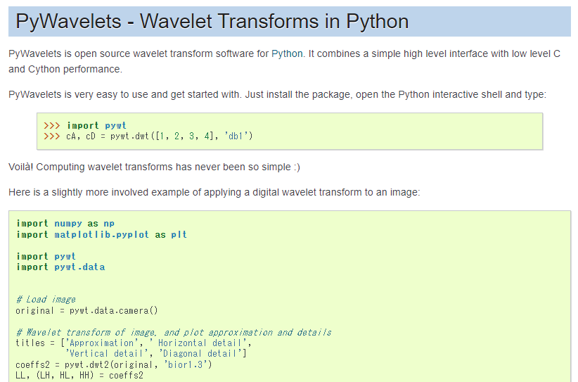

Aim of this course 2/2
“wavelet transform Python”
I want to wavelet transform my .csv files…
Sample code is doing this
Document is explaining that
I know how to edit the code to get what I need

Slide 4
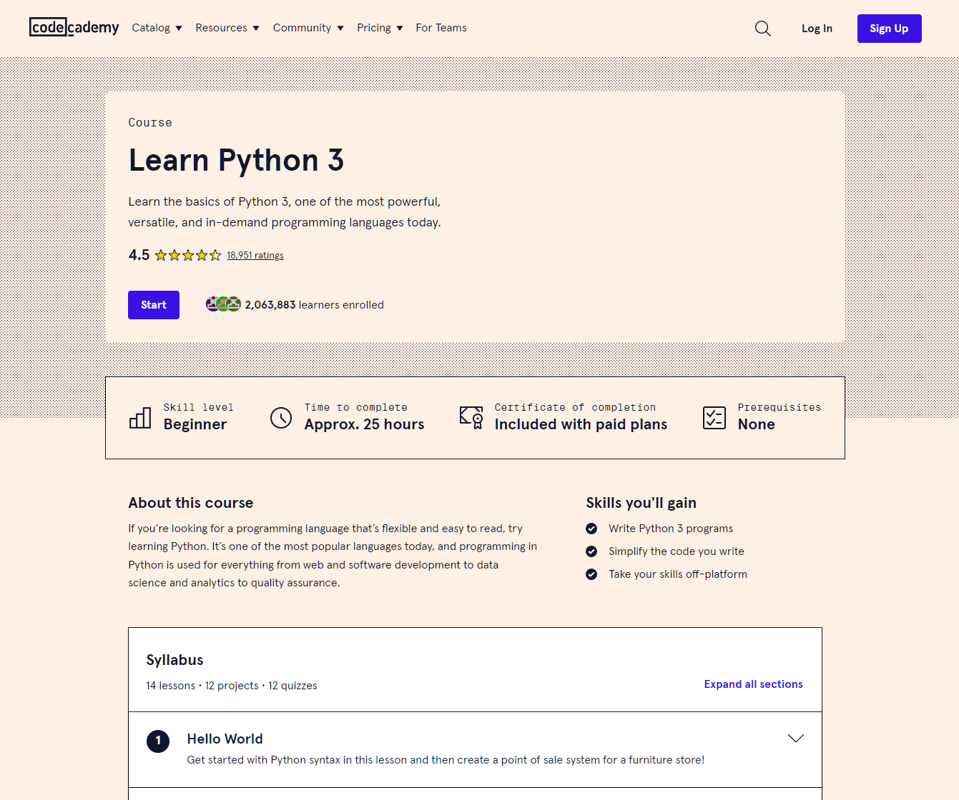
Things that this course doesn’t cover
ABC of coding find books/online courses
Machine learning: natural language processing sorry, not my interest
From questionnaire:
Runtime optimization I need more details but search for “refactoring”
GUI sorry, not my interest (but I’ll tell you how to learn)

Slide 5
Contents
What is/why Python?
Environment
Prepare coding interface
Visual Studio Code
Jupyter Notebook
Input support by extensions incl. GitHub Copilot

Slide 6

What is/why Python?
An artificial language for coding
Easy to learn/write (compared to other languages)
Widely used in science/engineering (AI, deep learning, etc.)
Many libraries (= set of tools for common processes)
Open source
Free!

Slide 7
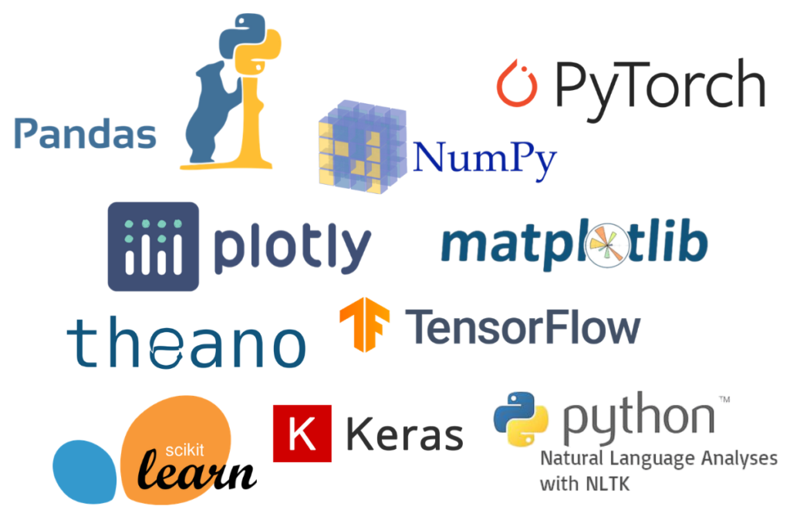
Python libraries (packages)
Mathematics
Plotting
Signal processing
Statistics
Database
Machine learning etc.

Slide 8
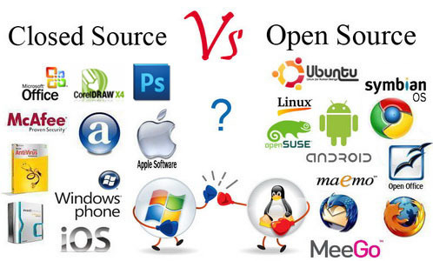
Open Source
Always improving
Free to
run
distribute
study
modify

Slide 9
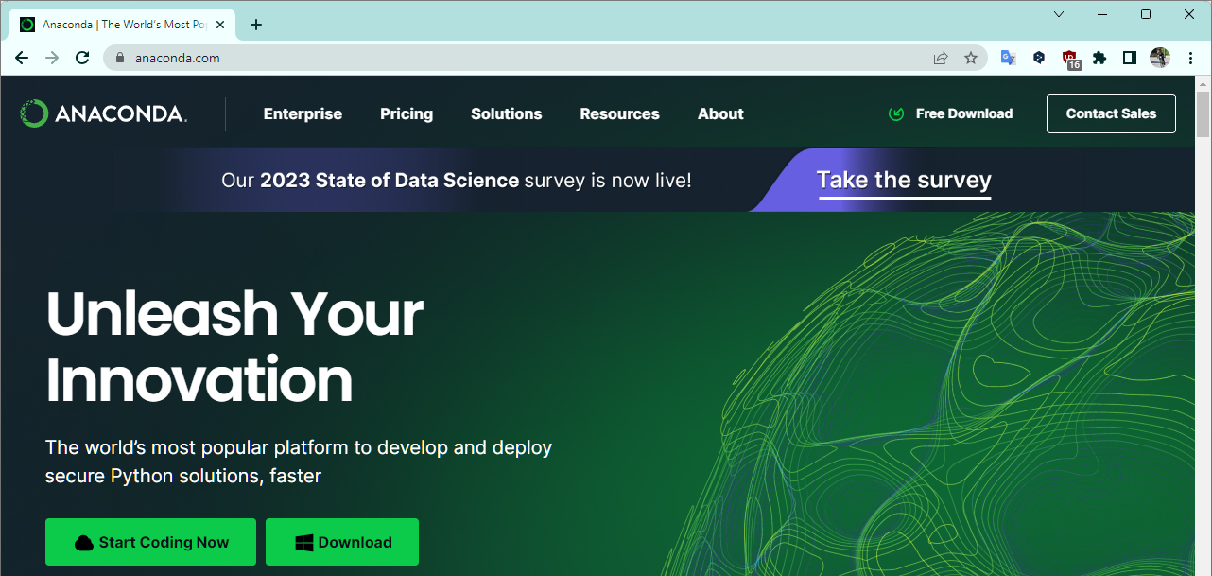
Setting up coding environment

Slide 10



How Python codes actually run?
Human readable language
Machine language
print(‘Hello world!’)
010101010101
“Interpret” contents

Slide 11



Libraries (packages)
More complicated calculations
Version 2.x, 3.7, 3.8, 3.9, 3.10, 3.11…
Plotting
Basic functions:
File open/close
Arithmetic operations
String search/replace
…
Machine learning
…and more!

Slide 12


Sometimes requirements are different
Python 3.7
numpy 1.19.2
matplotlib 3.3.1
Python 3.11
numpy 1.25.1
matplotlib 3.7.2
Project A
Project B

Slide 13
Different versions, different environments
Python 3.7
numpy 1.19.2
matplotlib 3.3.1
Python 3.11
numpy 1.25.1
matplotlib 3.7.2
Project A
Project B
Environment for A
Environment for B

Slide 14
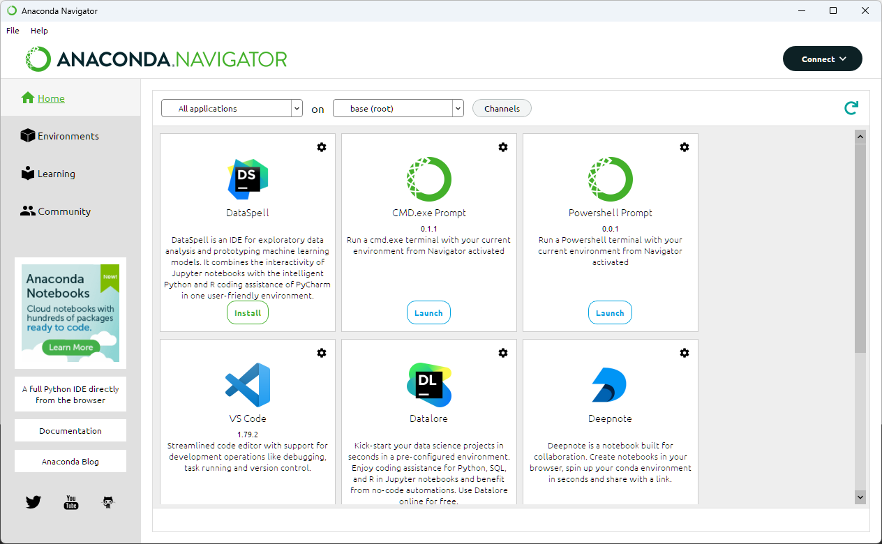
Environment/package manager

Slide 15
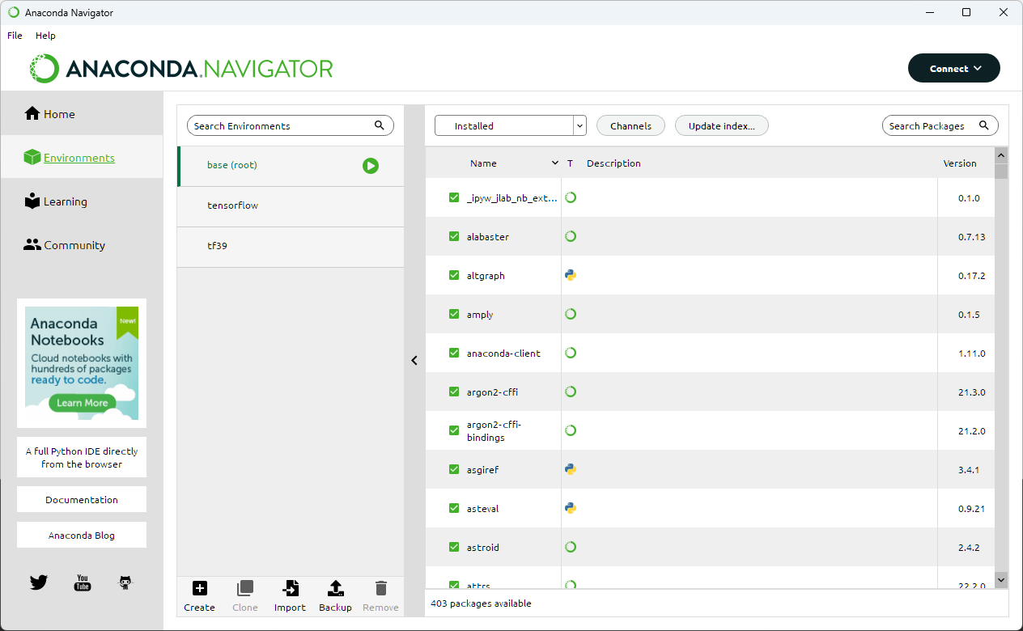
Environment/package manager
Packages installed in the env
Some important packages are already there:
numpy
scipy
matplotlib etc.
List of environments you created

Slide 16

Docker – recreate same environemnt
All-in-one environment compressed as a “container”
Shareable
Portable
Works on any OS

Slide 17
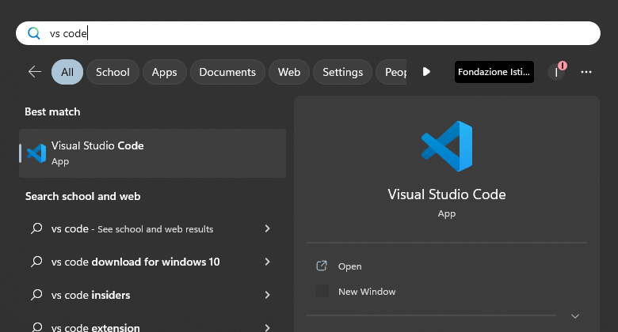


Let’s code! – Launch VS Code
Double click this icon
or
[Windows] → vs code → [Enter]

Slide 18


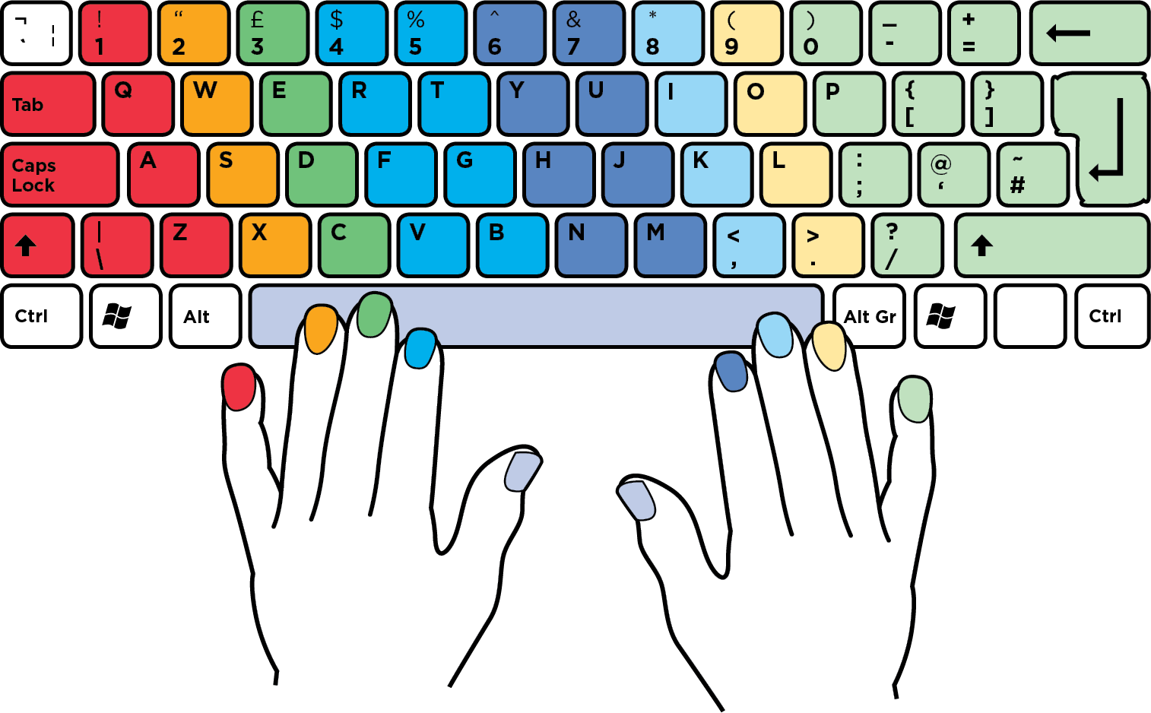
Minimize your hand movement
Improves your posture
Reduces backpain + neck pain
Shortcut keys are made for this hand position
Fast and furious!

Slide 19
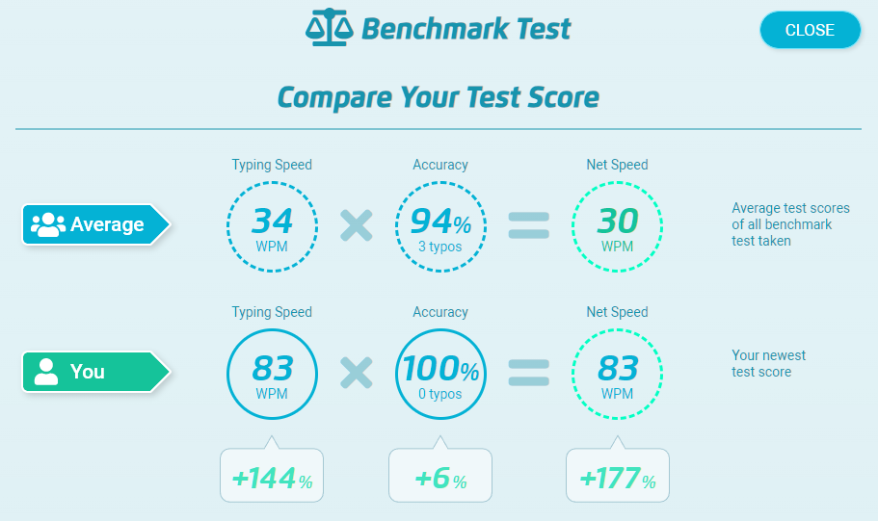
Typing speed helps you
From typingtest.com - challenge accepted!

Slide 20
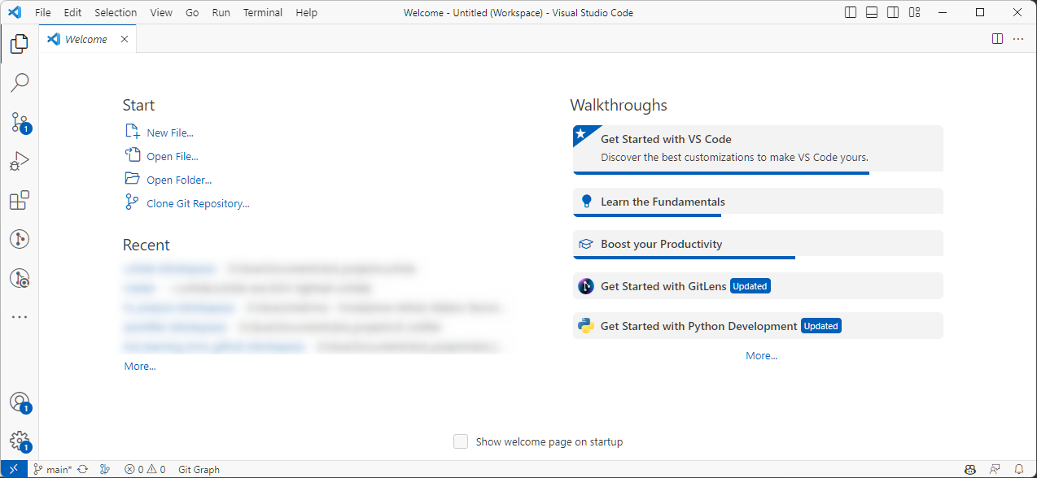
Visual Studio Code
Keywords: environment, Visual Studio Code, Jupyter Notebook, GitHub Copilot, Docker, Google Colab

Slide 21
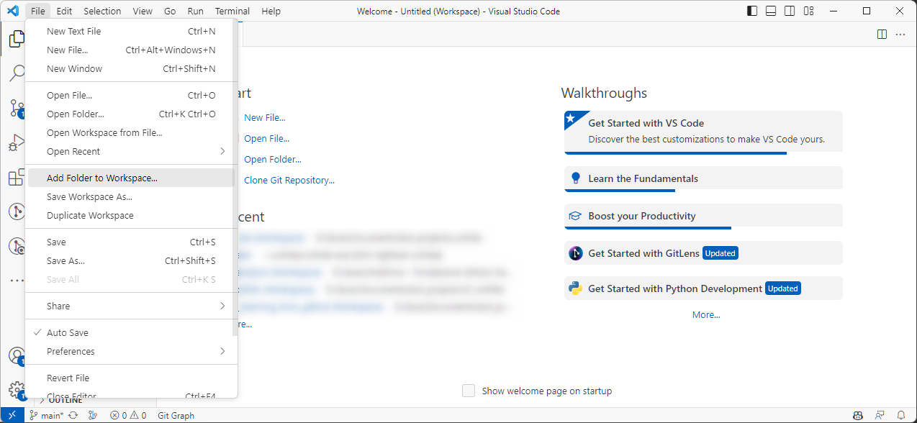
Assign a new folder

Slide 22
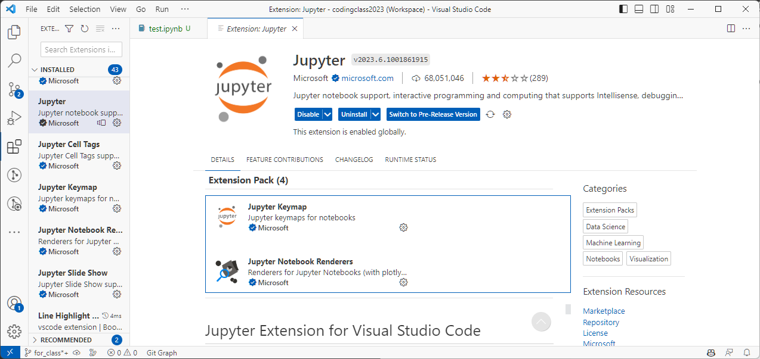
Install Jupyter extention
jupyter

Slide 23
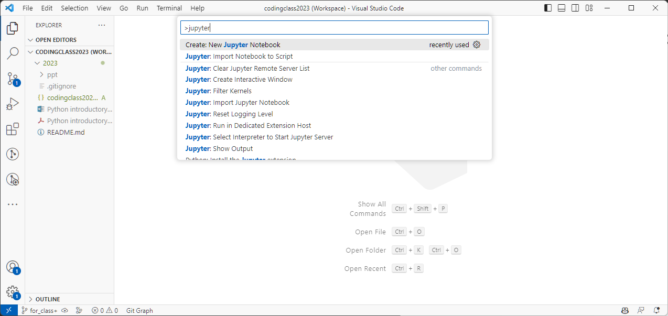
Create your first file
[Ctrl] + [Shift] + P → jupyter → Enter
[View] → [Command Palette] → jupyter → Enter

Slide 24
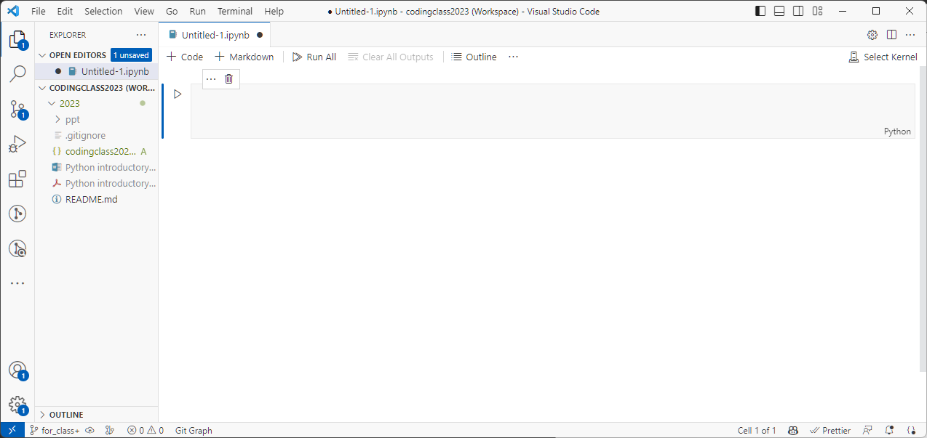
Jupyter Notebook: save it first
[Ctrl] + S

Slide 25
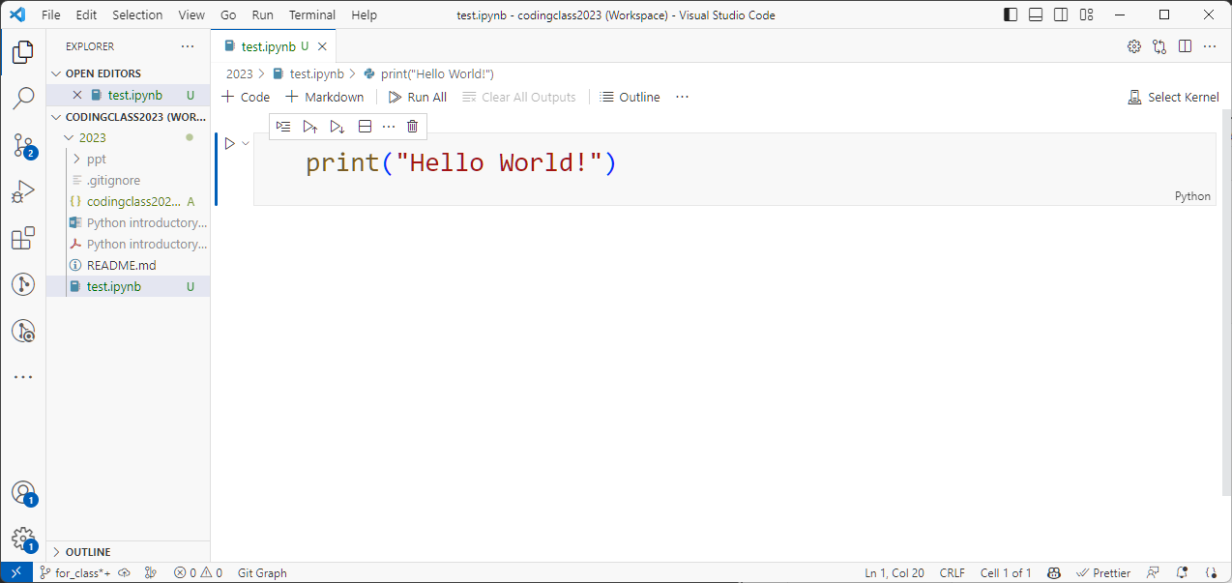
Interface
Click this cell and start typing

Slide 26
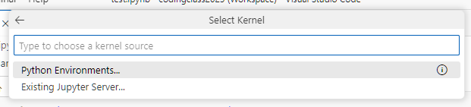
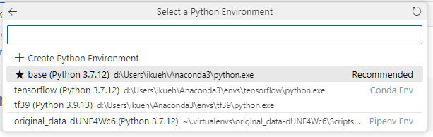
Run the cell
[Ctrl] + [Enter]
Default is ‘base’

Slide 27
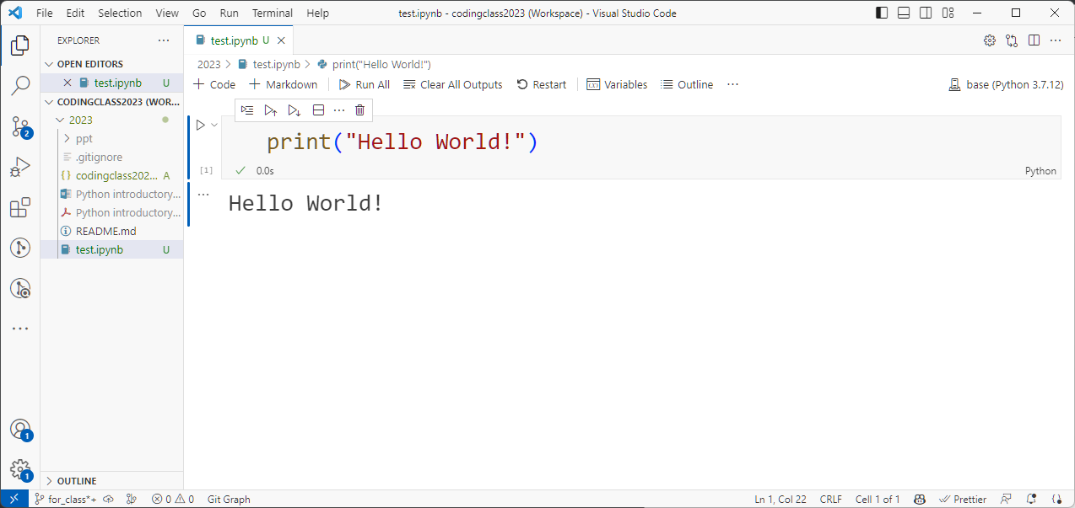
Result

Slide 28
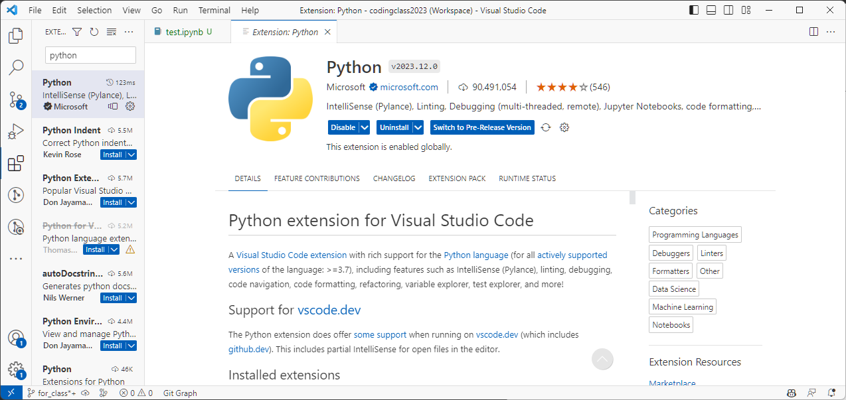
Extensions – improves efficiency

Slide 29
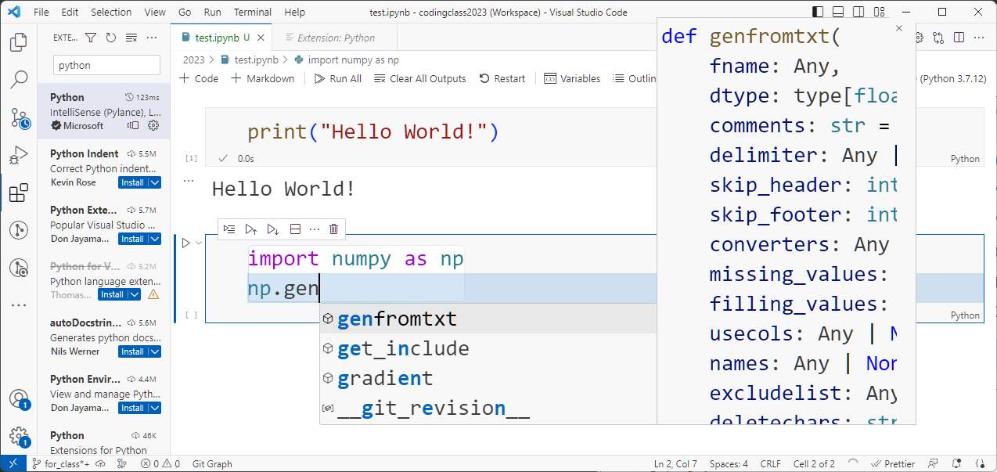
Suggests & shows documents on the go

Slide 30
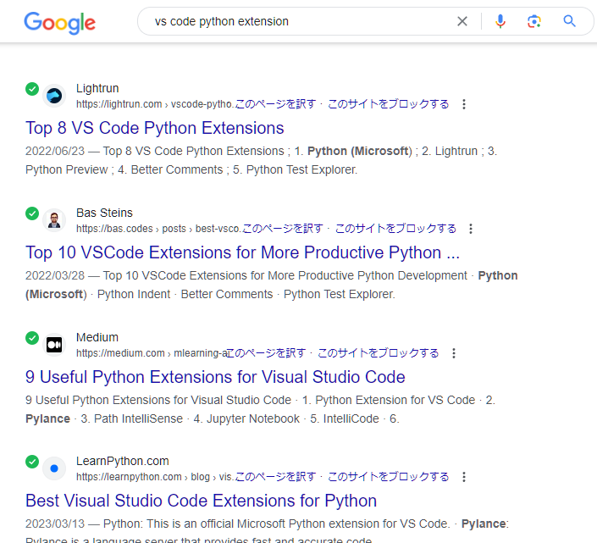
Find ones that suit you

Slide 31
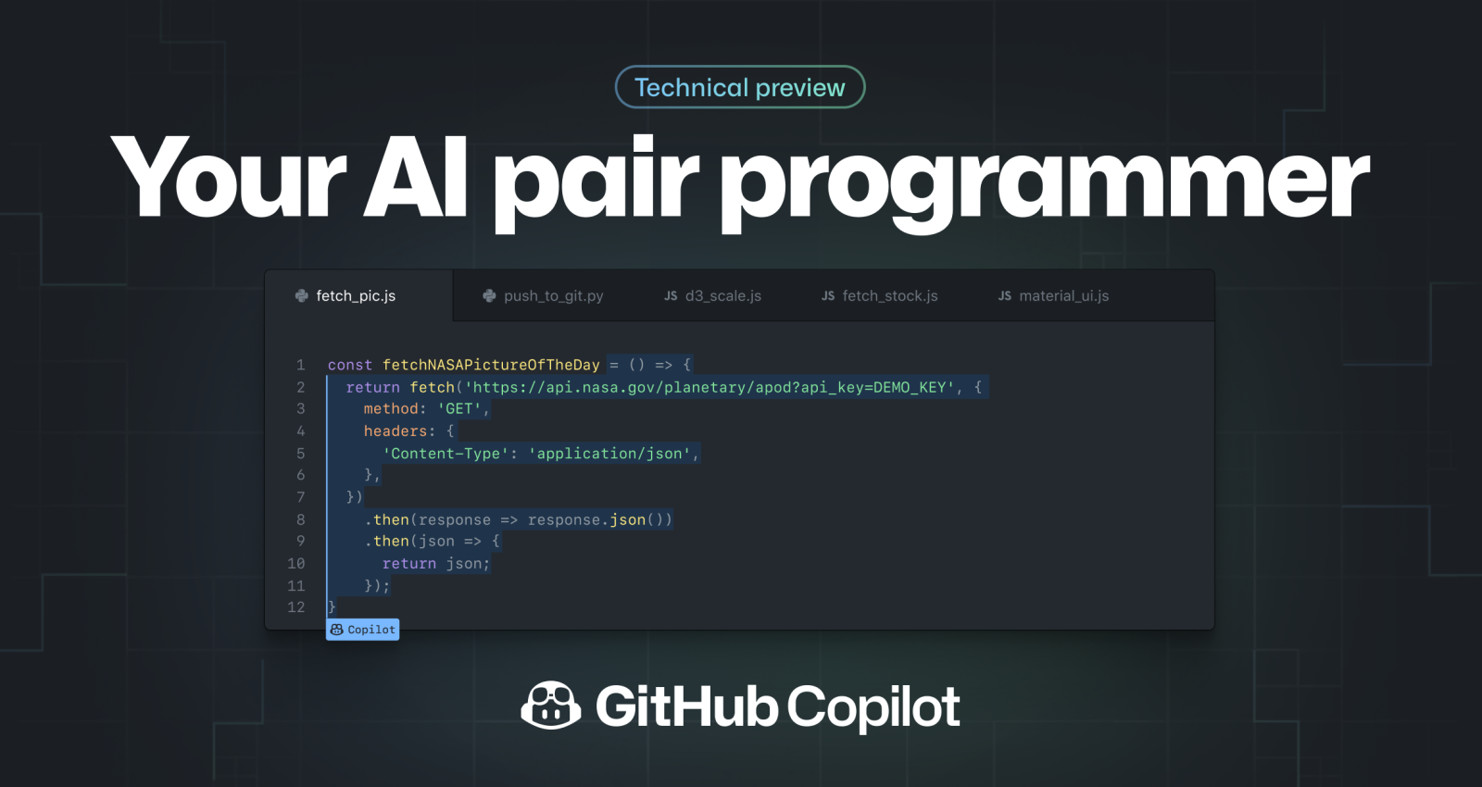
AI assisted coding – GitHub Copilot

Slide 32
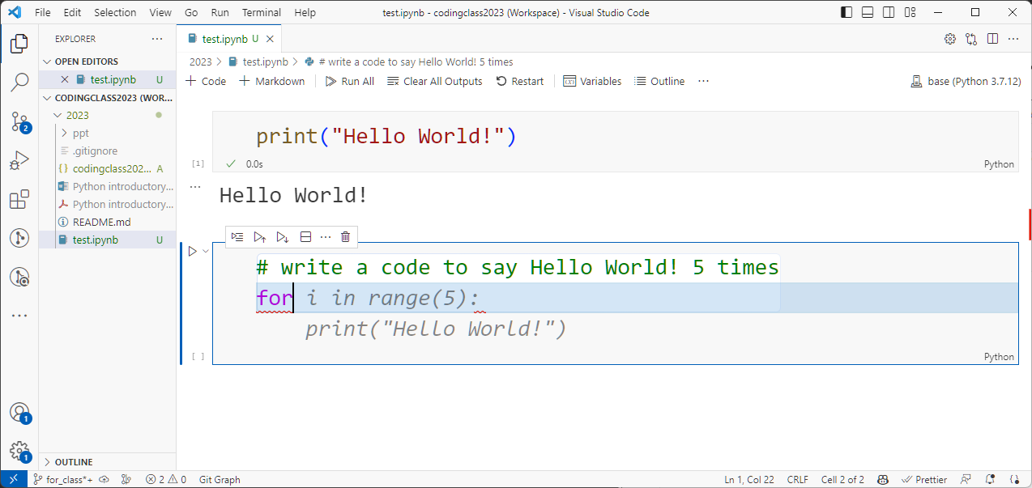
GitHub Copilot

Slide 33

Copilot pros and cons
Pros:
Drastically increase coding speed
Less mistakes
Cons:
Copyright problem - everything is learned from GitHub
Lawsuit ongoing
Paid
https://githubcopilotinvestigation.com/

Slide 34
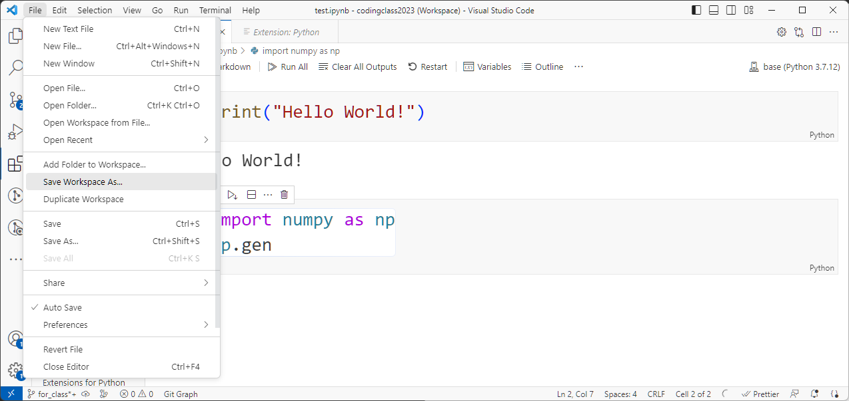
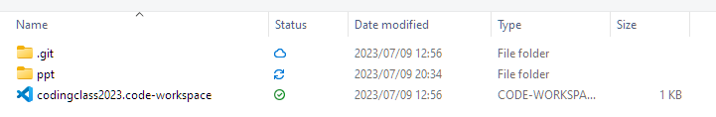
Save your workspace

Slide 35
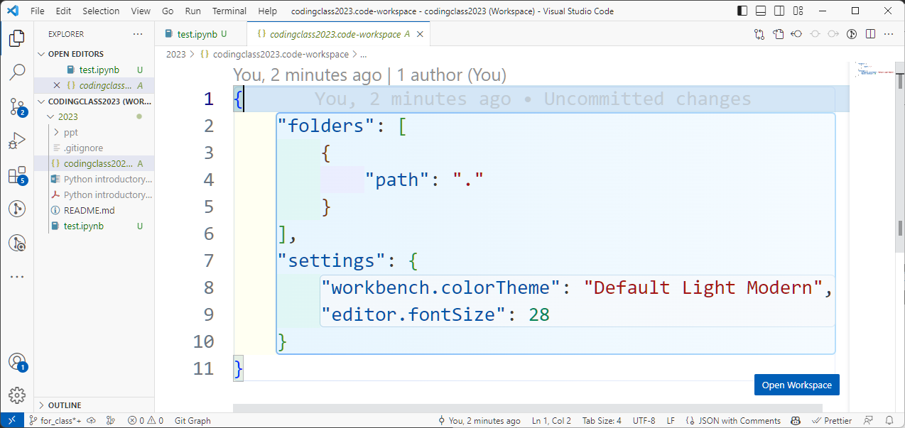
.workspace

Slide 36

Textbooks for this lesson
For newbies:
Jupyter Notebook:
Online courses
Allen B. Downey “Think Python: How to Think Like a Computer Scientist” O'Reilly Media
Visual Studio Code, Jupyter Notebook in VS Code
Many YouTube movies by VS Code
Amazon.it
HTML

Slide 37
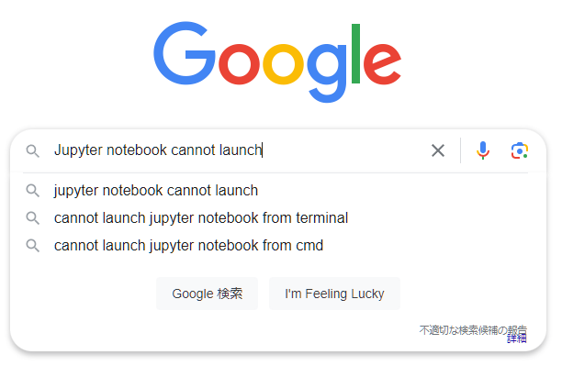
If you have problems…
Stack Exchange, GitHub issues…
Somebody must have experienced your problem

Slide 38
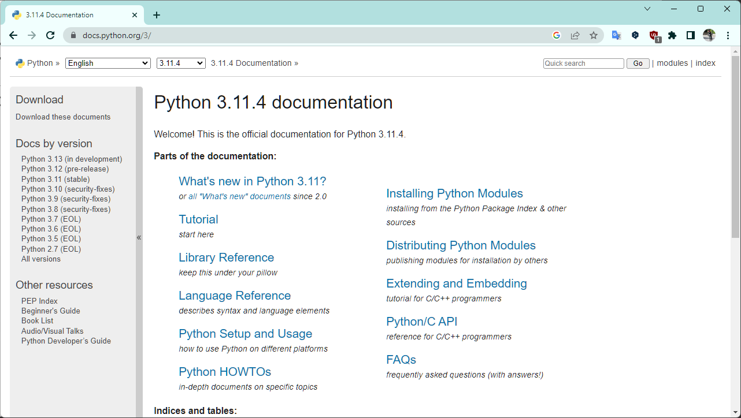
Your friend: official documentation

Slide 39

Not your best friend: me
Google it

